Slide 1

Wayfinders
Harley Garza and Franklin Micle

Slide 2






Wayfinders TEam
Franklin Micle
Harley Garza
Tools:

Slide 3
Wayfinders Project
OVerview
Objective: Choose a cause and create a high fidelity clickable prototype.
Time Frame: Three Weeks
Problem: Teachers are struggling to keep students engaged in their academic downtime that is both comprehensive and effective.

Slide 4
Research and Analysis

Slide 5
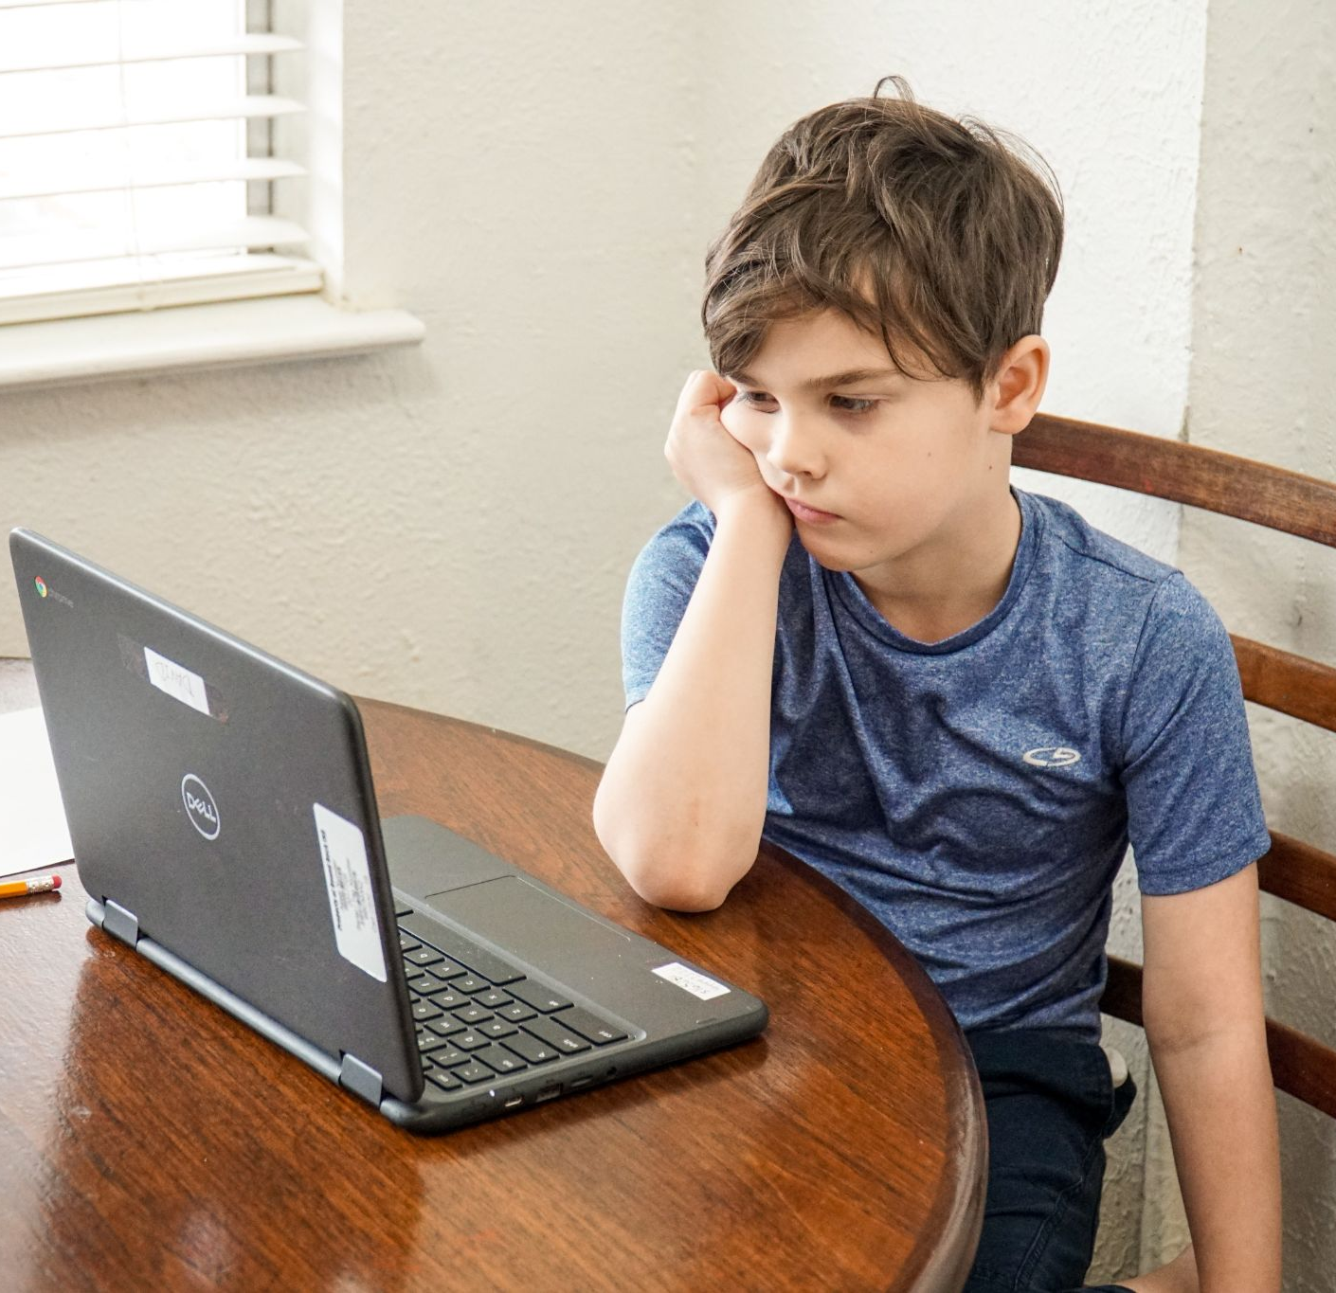
Context and Hypothesis
Initial Assumptions
Students have varying degrees of achievements.
Students are becoming less engaged.
Teachers need a tool that is flexible and affordable.
Hypothesis: By creating an educational game website, we can help provide teachers with student-directed game content that will keep students engaged during downtime but also help them advance academically.

Slide 6
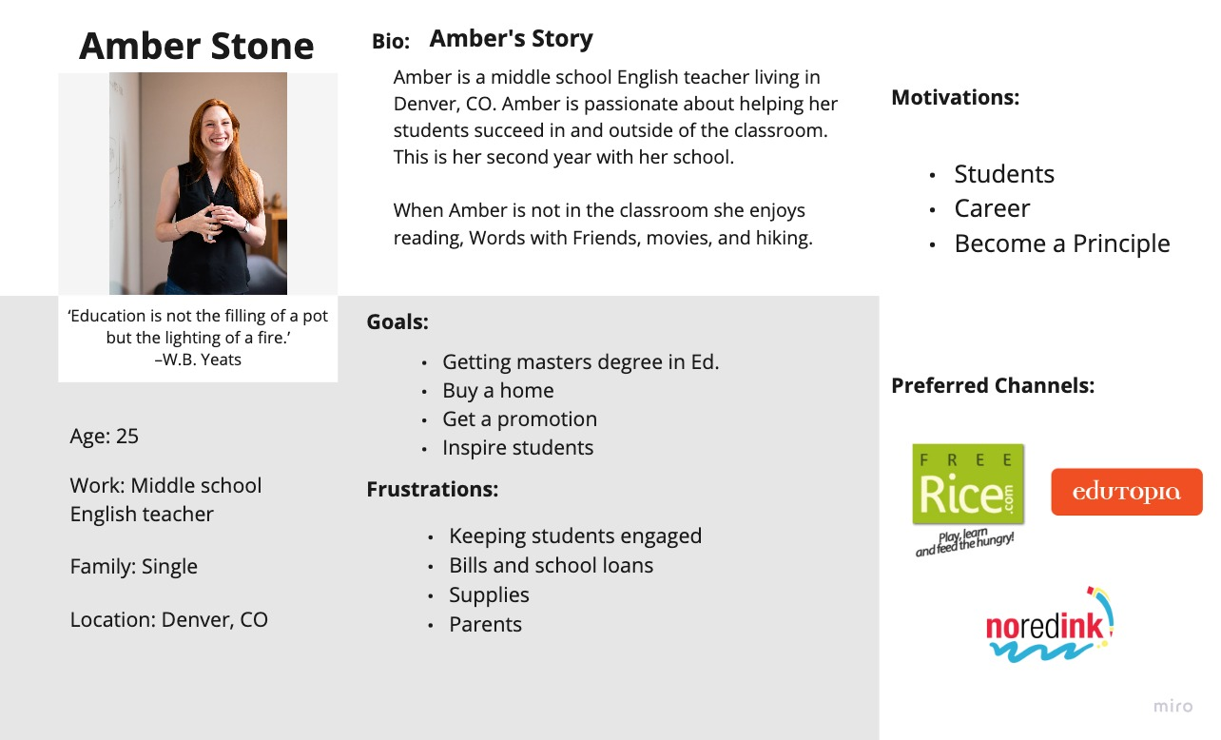
Proto-persona
Middle school English teacher
Enjoys reading, Words with Friends, movies and hiking
Her students are one of her motivations
Biggest frustration is keeping students engaged

Slide 7
Interview and Analysis Process
Methodology: 6 1:1 interviews with working teachers.
Significant Quotes
“... unless the district buys into a program, it's almost unaffordable or we only get the basic version [because] it's free.”
“So they like games, they're engaged by games, and I think that would make that better. So some type of competitive feature would make it better for them or even just like making it a game.”
Interviews and Transcripts Folder

Slide 8
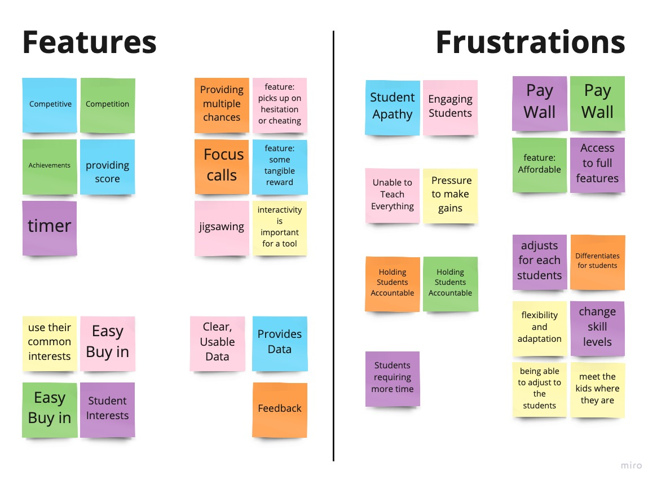
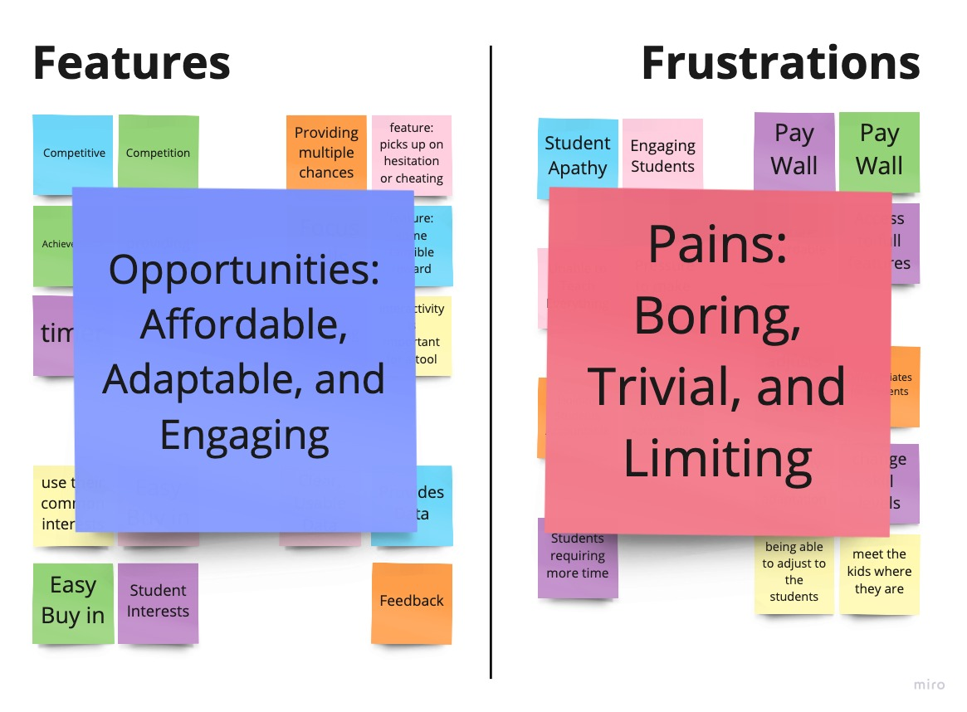
Analysis and Findings
Key Takeaways
Current tools require teachers to pay in order access content.
Tools are either educational or engaging, rarely both.
Teachers want a tool that can adapt to student needs.
Teachers want a tool they can use to create customized assessments.
Miro Board

Slide 9
Competitive analysis
Competitors studied: Direct: Classcraft, Freerice, Blooket Indirect: Kongregate, Armorgames
Pros
Create custom questions
Standards based
Side navigation most effective
Highly engaging
Cons
Most useful site requires paid account (Classcraft)
Navigational issues
Requires specific programs to upload question sets.

Slide 10
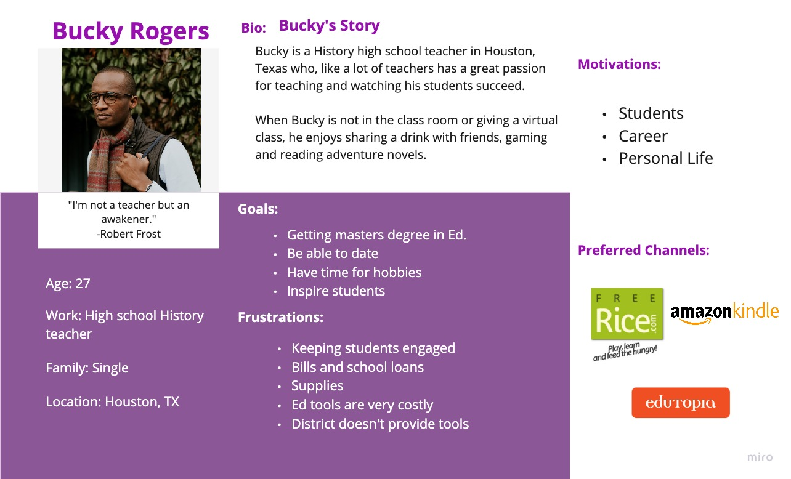
User Persona
High School History Teacher
Loves gaming and adventure novels
Wants to provide a unique experience for his students
Can’t afford current tools without district help.

Slide 11
Ideation and Wireframing

Slide 12
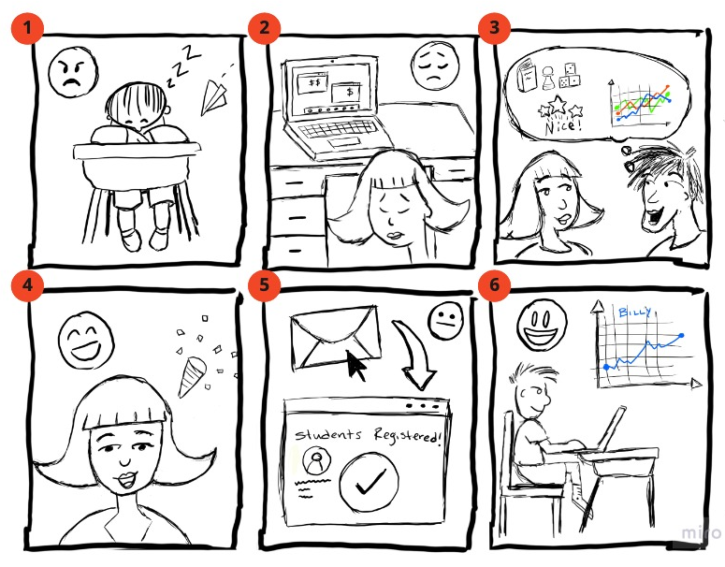
Storyboard
Ms. Quinn is struggling to keep students engaged.
Ms. Quinn is discouraged when she sees many current require payment to use.
Mr. Brown a fellow math teacher, Ms. Quinn teaches with suggests using Wayfinders.
Ms. Quinn is excited to find that the sign up is not only easy, it’s free!
She registers her classes and students.
Ms. Quinn is delighted to see her students are now more engaged and she is able to track her students progress as well.
Link to Storyboard

Slide 13
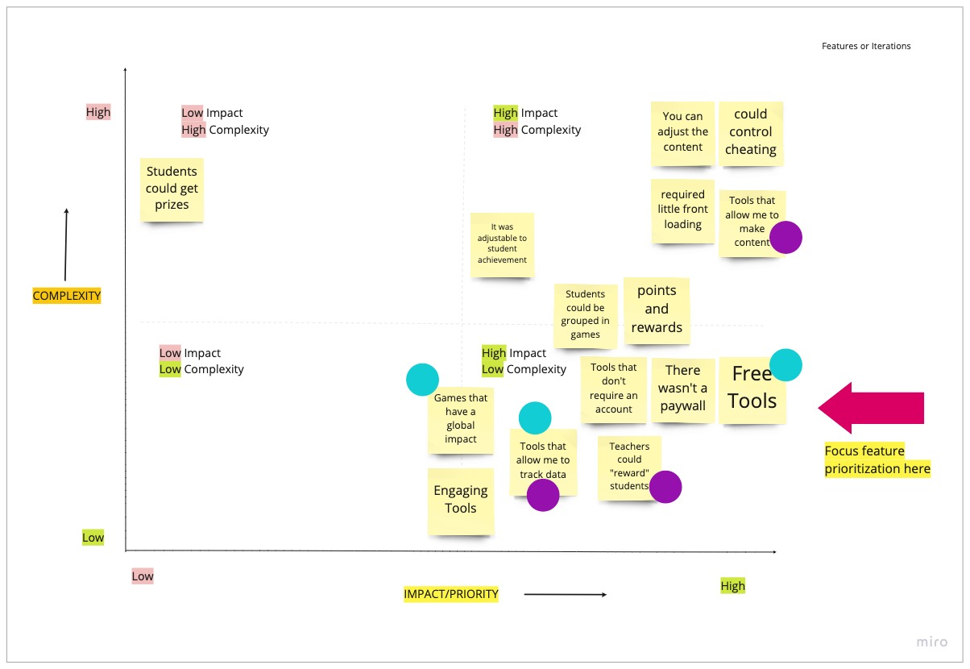
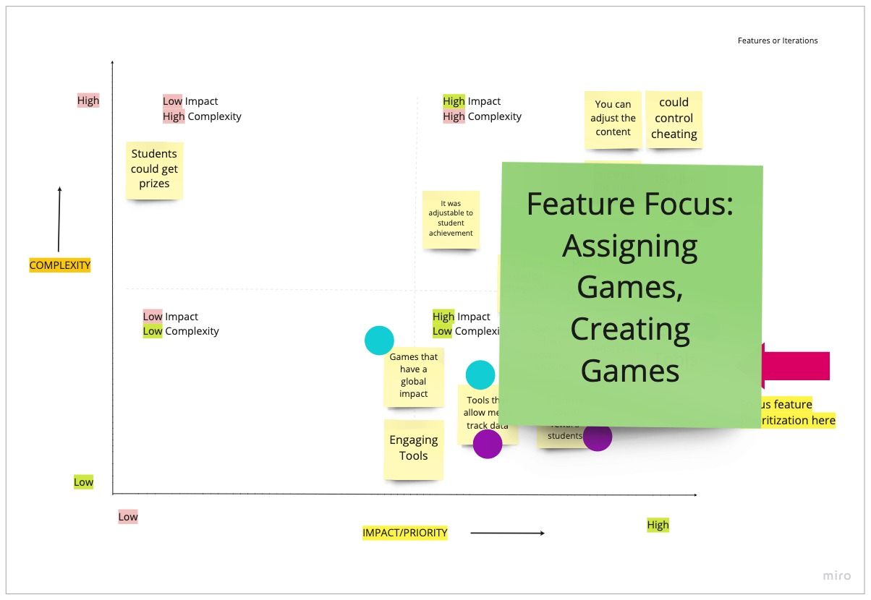
Feature List
Tools used:
I Like, I Wish, What If
SWOT Matrix
Focused User Paths
Assigning premade games
Creating custom games
Implied features through design
Data tracking, Community made library, Reward System

Slide 14

Assign Games Wireframes
Priorities:
Clear Navigation
Simple procedure
4 clicks to complete minimum
More depending on number of assigned games
Ability to filter by student or assign to class.
Lo-Fi Wireframes

Slide 15
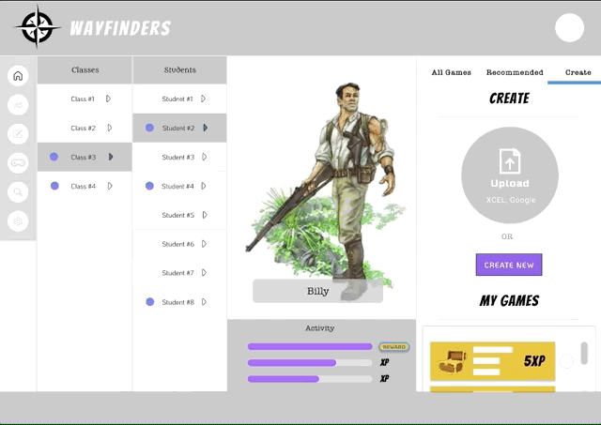
Create Game Wireframes
Priorities:
Teachers can use Excel of Google Sheets to upload custom questions.
Access to library of teacher made content.
Simple questions creation interface.
Stores previously made games.

Slide 16
Prototyping and testing

Slide 17

User Testing
Methodology: 3 users tests
Objectives:
Assign games to student
Create game for class
Biggest Takeaways
Pros: Intuitive interface, clear CTAs
Cons: Ability to change question types, Copy sizing needs adjusting
User Testing Notes

Slide 18
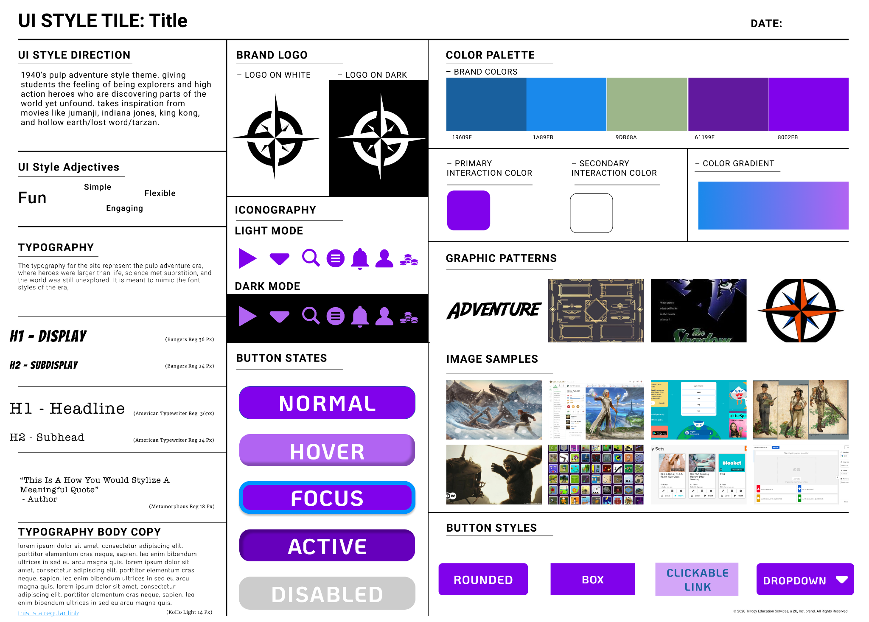
Brand Style
Brand Theme
1940s Pulp Adventure
Simple but vibrant color palette
Typography to mimic the dime novel style.
Inspirations
Hollow Earth RPG
Indiana Jones
Jumanji: Welcome to the Jungle
Works of Edgar Rice Burroughs
Full Style Tile

Slide 19
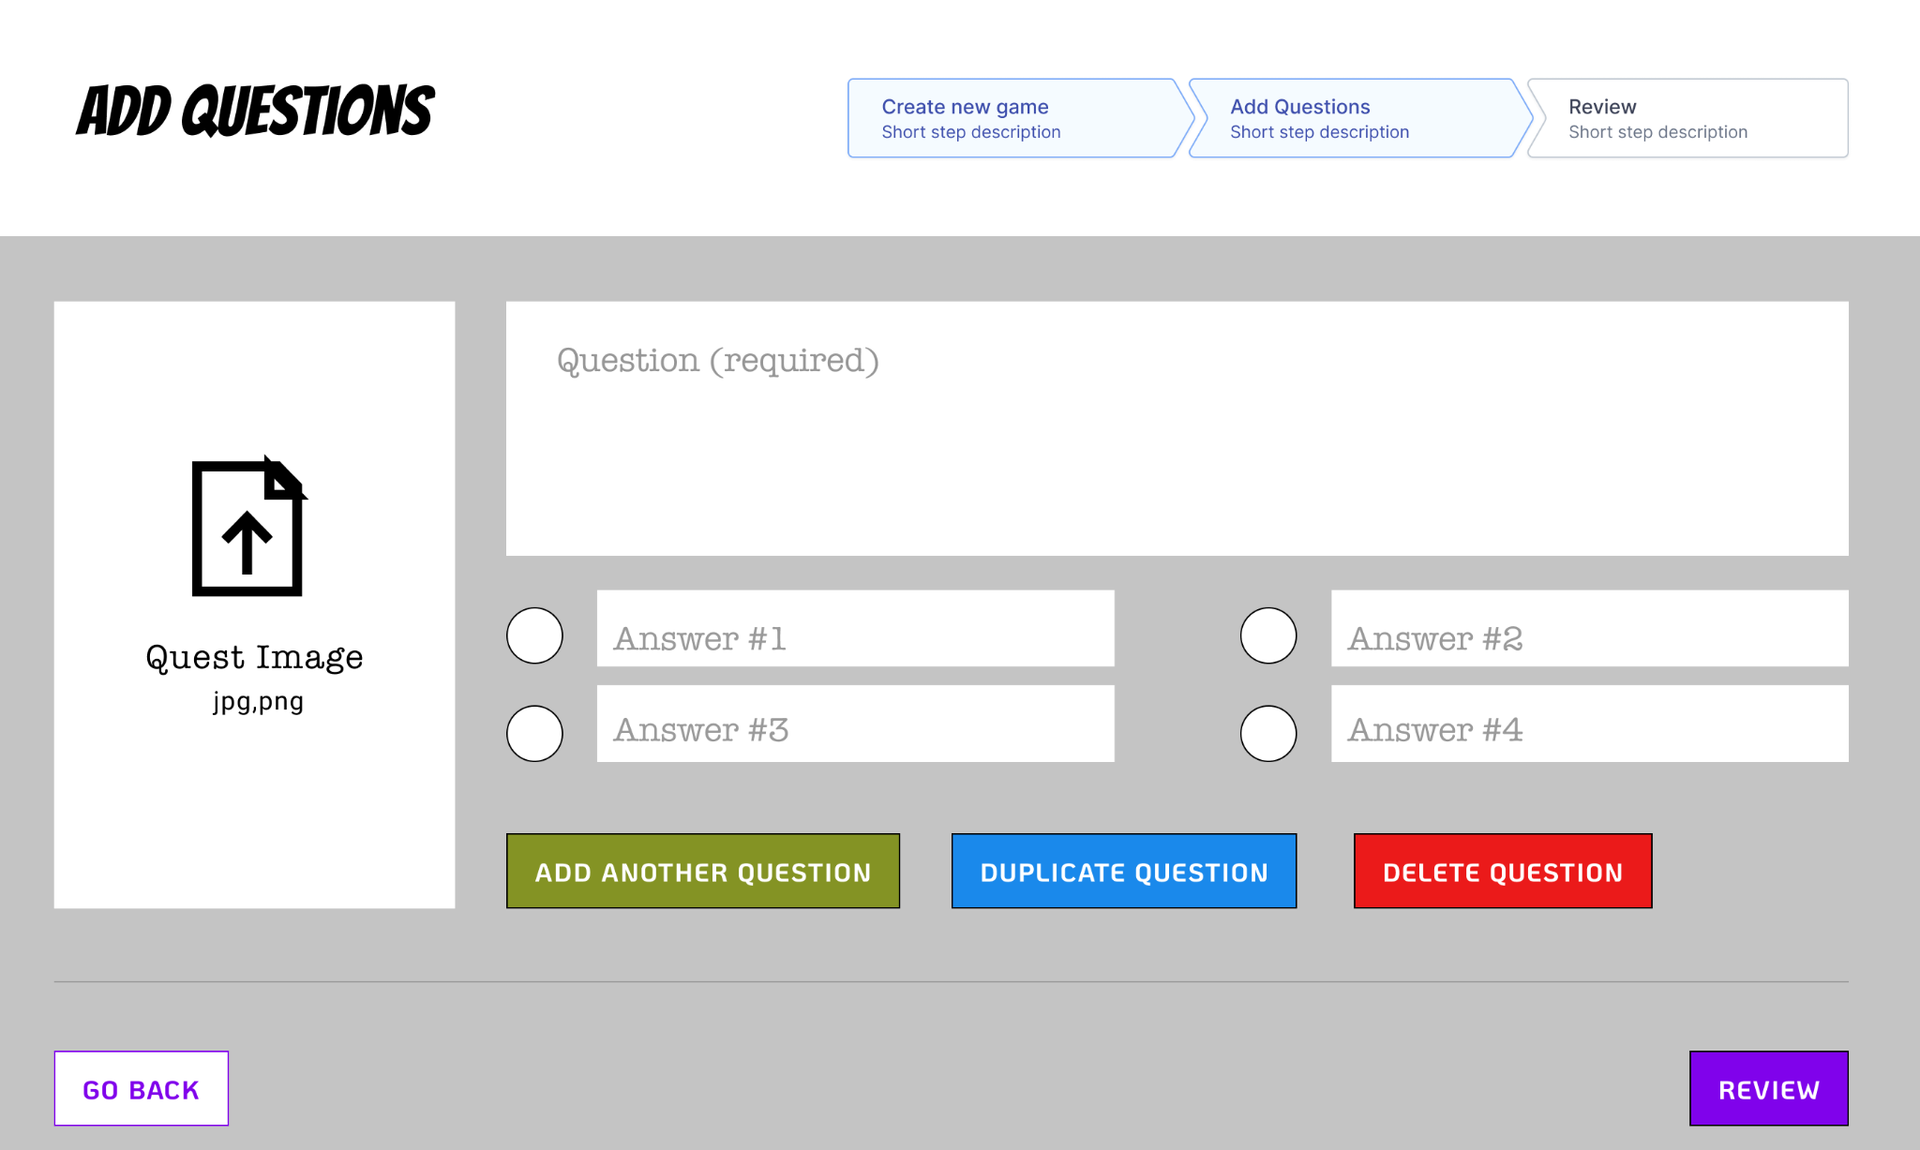
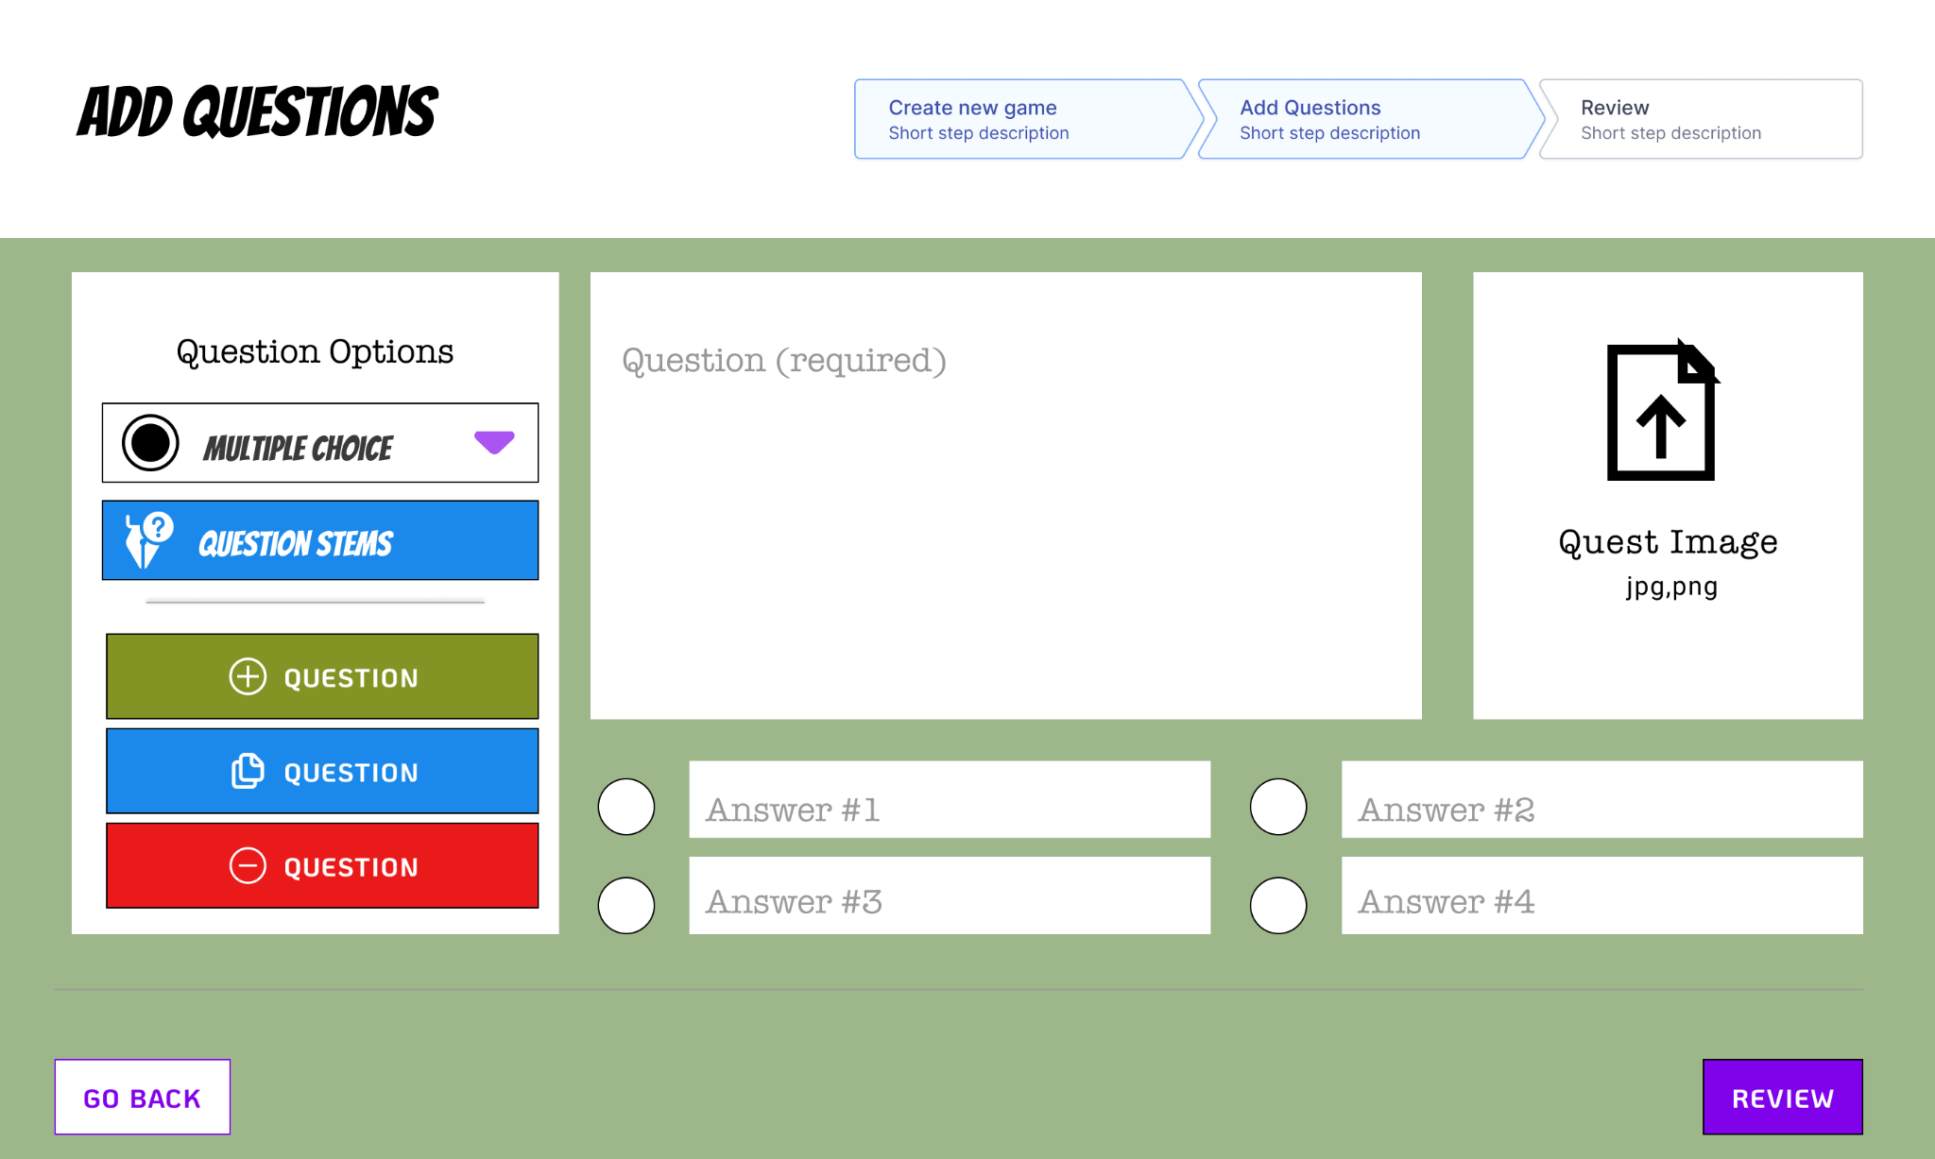
Iterations: Question Creation
Biggest Iteration:
Ability to change question types
Question sentence starts
Changes Made:
Addition of question type drop down and Question Stem database.
Uniform button sizes.
Rearranged layout to keep modular design.
Hi-Fi Wireframes

Slide 20
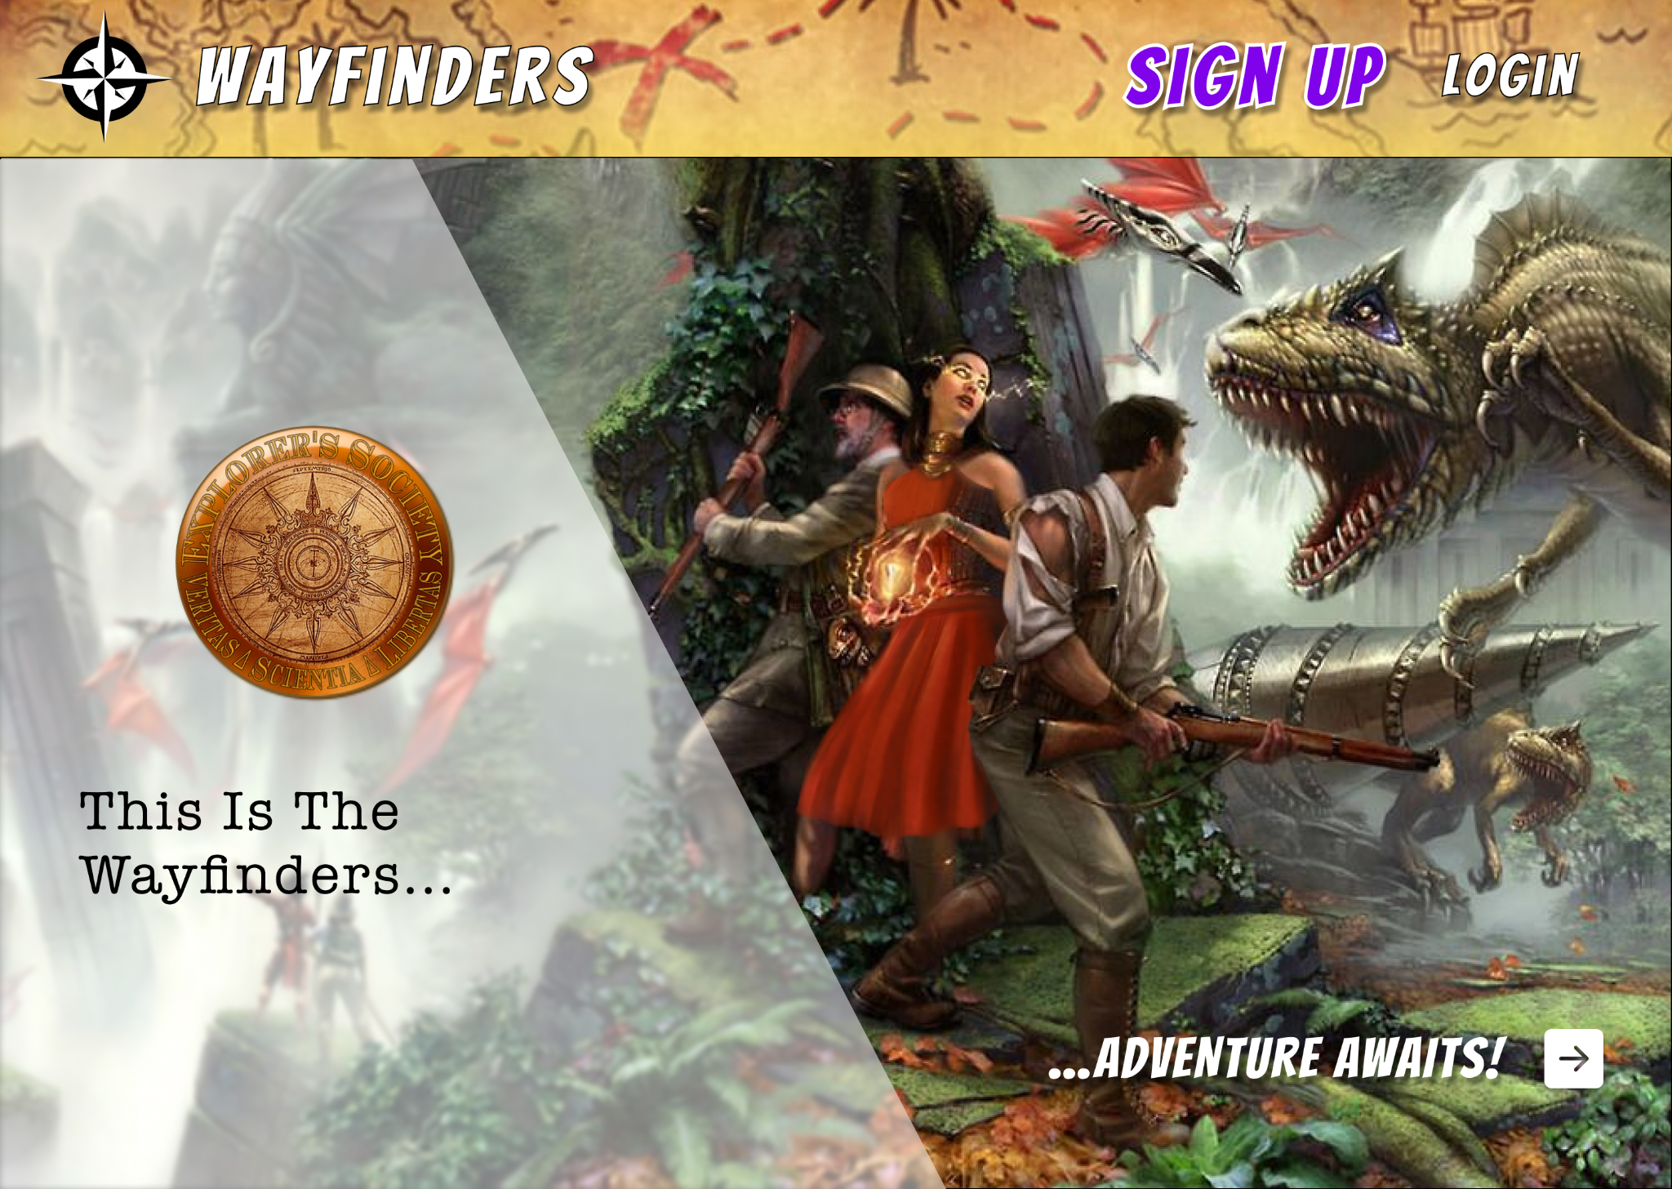
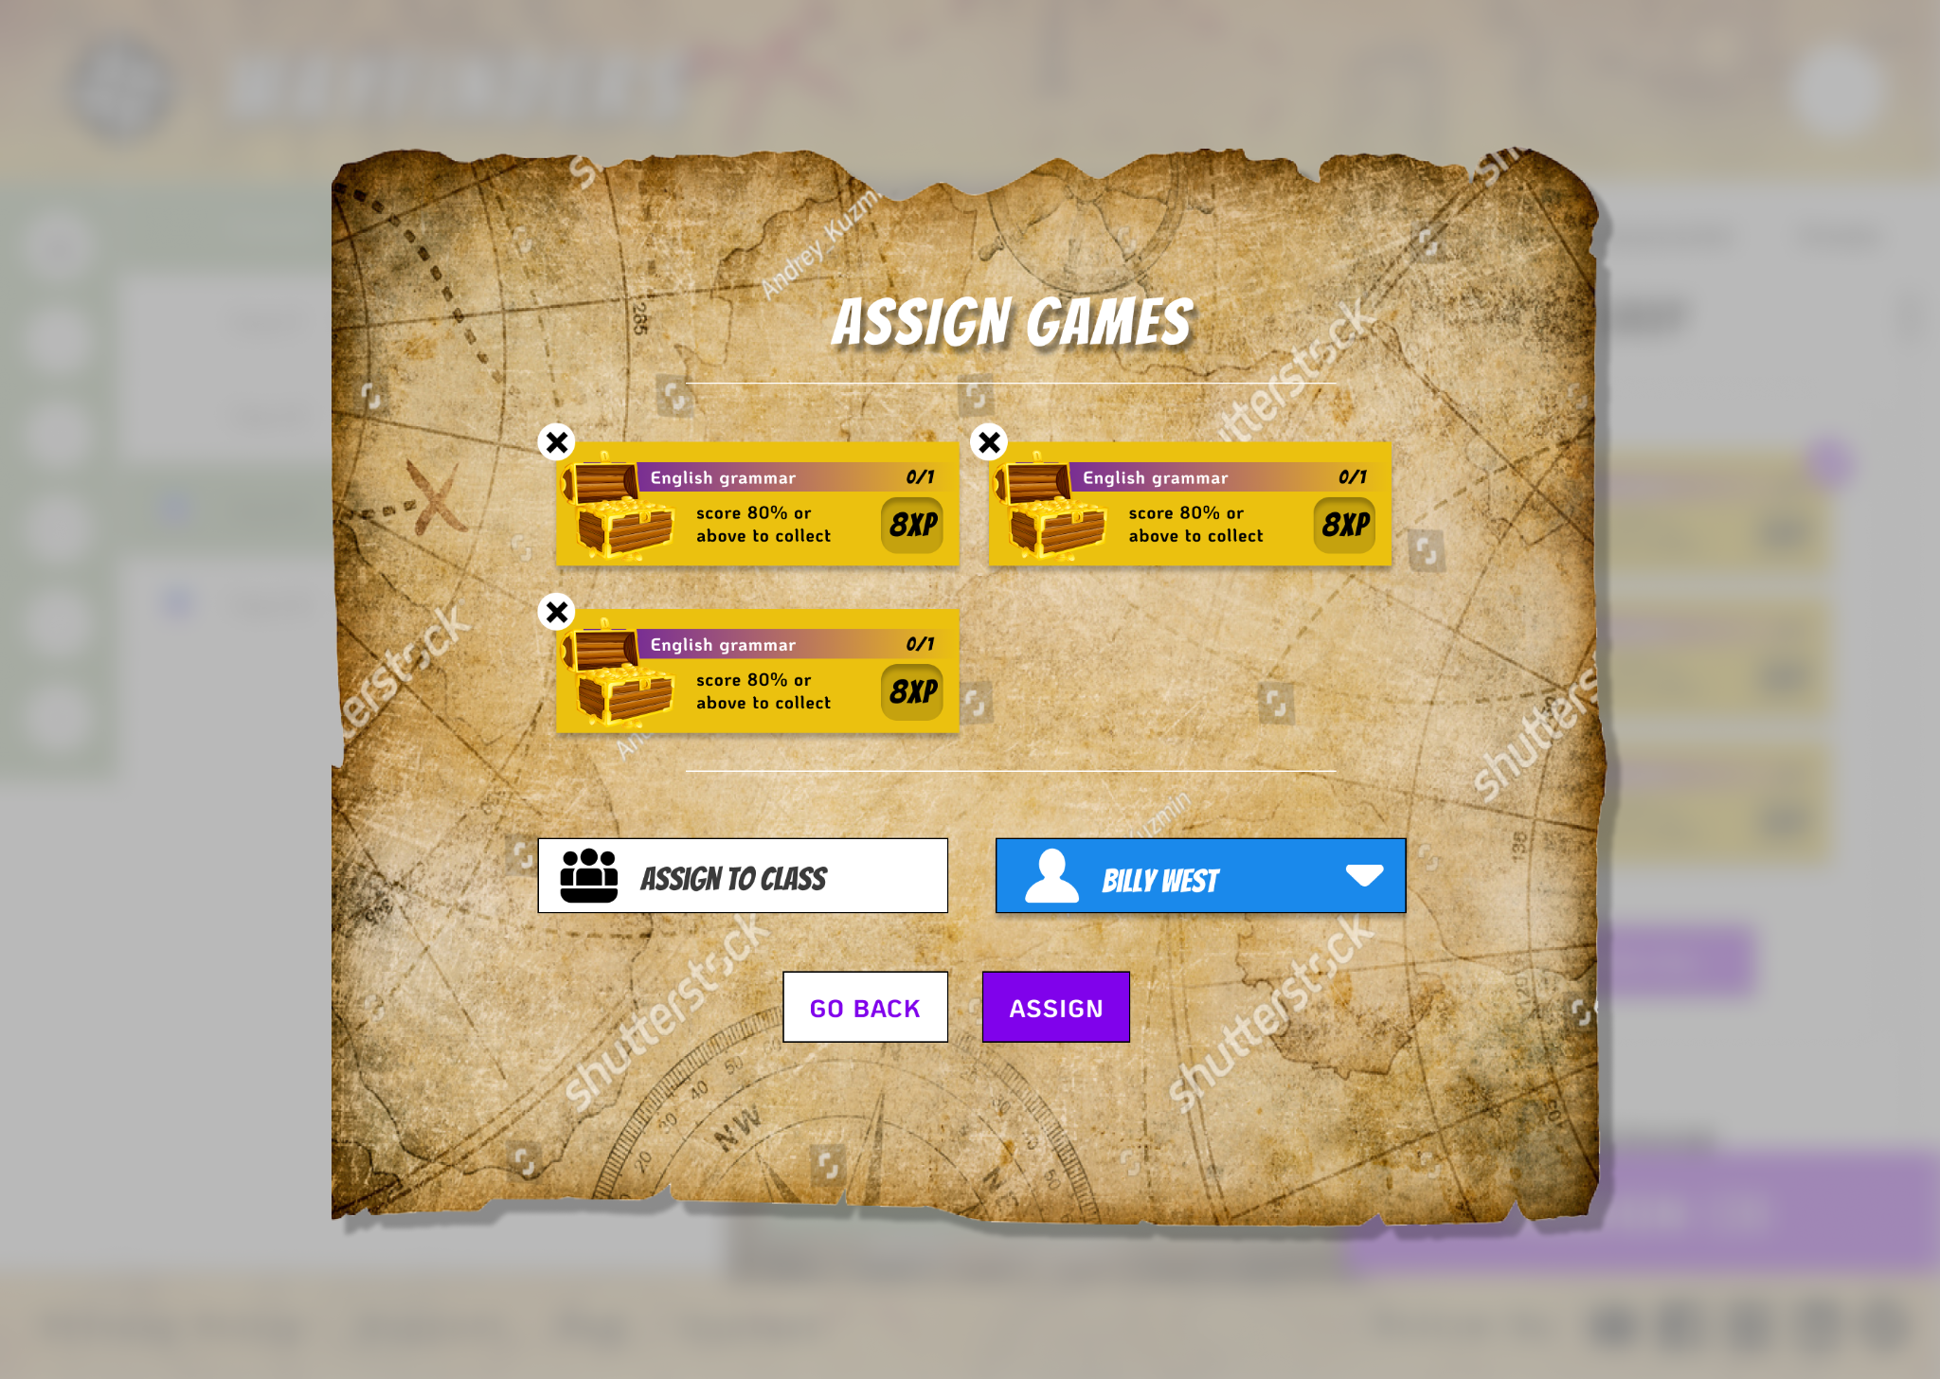

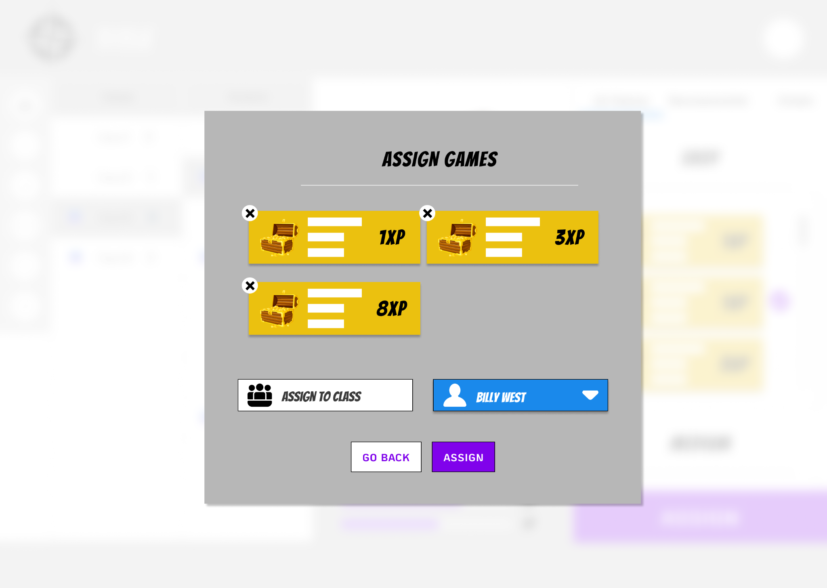
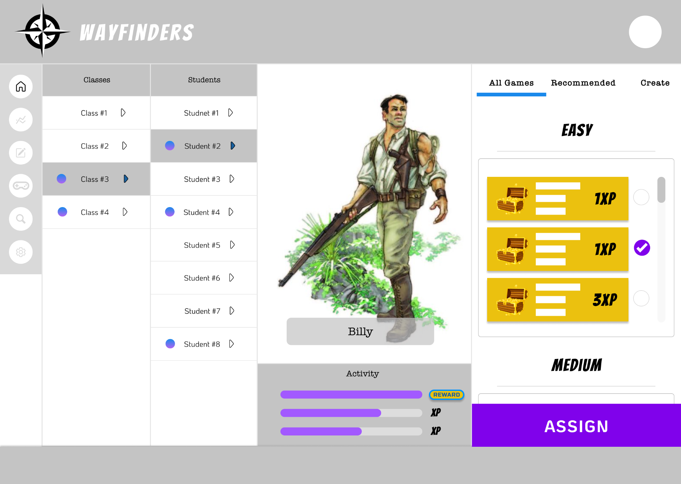
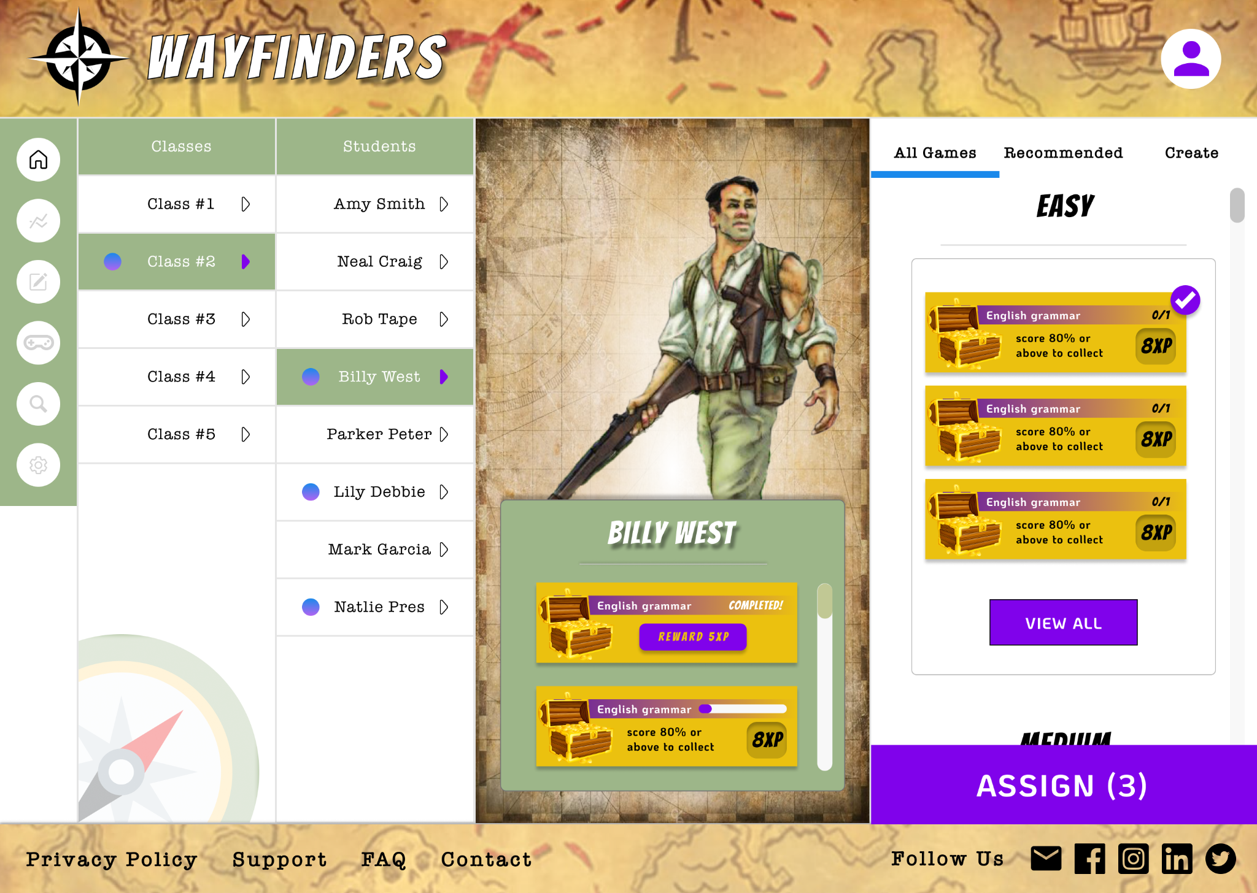
Hi-Fi Mockups

Slide 21
Final Prototype & Next Steps
Key Takeaways
The problem of the user must be central to the project
Trust your partner
Next Steps
Get custom art made
Integrate global impact feature
Build out library of games feature
Determine student user flows
Build Mobile Version

Slide 22
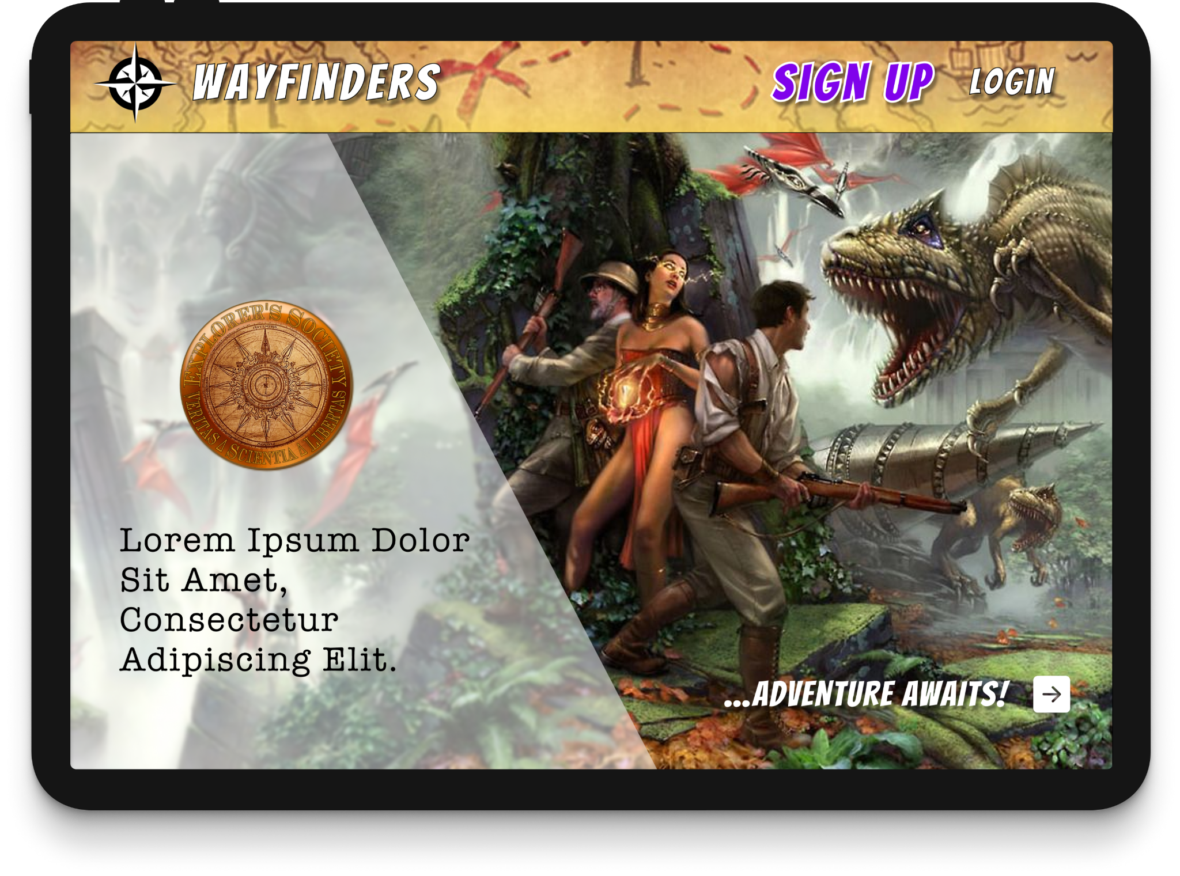
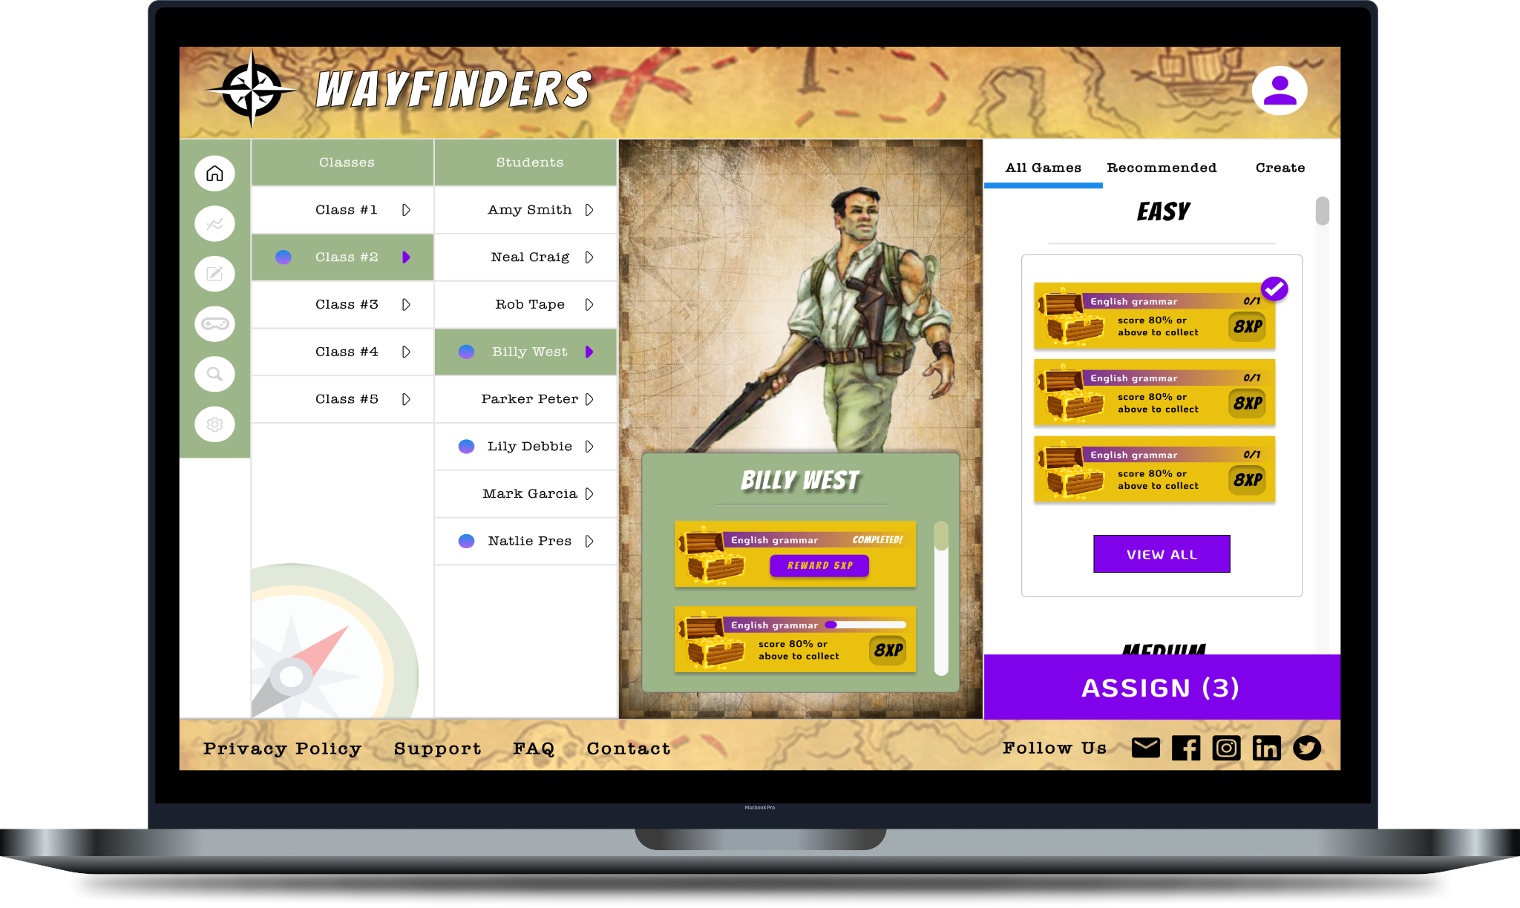
Final Prototype
User Flows Designed
Assigning Games
Creating Games
Link
Wayfinders Prototype

Slide 23
Questions?
Thank you for your attention!

